Slide 1

LIFE EXPECTANCY Data Analysis Dhanush M

Slide 2
Objective
In this project, we attempt to analyse and explore dataset for Life Expectancy in order to derive valuable insights and build a predictive model using ML

Slide 3
About the Dataset
The project relies on accuracy of data. The Global Health Observatory (GHO) data repository under World Health Organization (WHO) keeps track of the health status as well as many other related factors for all countries The data-set related to life expectancy ,Among all categories of health-related facs.
In this project we have considered data from year 2000-2015 for 193 countries for further analysis. The dataset consists of 22 Columns and 2938 rows.

Slide 4
Steps
Introduction
Data understanding
Data Cleaning
Outlier detection and handling
Feature Selection
Model Creation
Training and Testing of model
Testing assumptions

Slide 5
Introduction
• The Life Expectancy Dataset originated
from the Global Health Observatory,
which monitors the health status of
Countries. The United Nations website
was used to complete the economic Data
• There are various attributes to analyze
within the dataset. The following are some
of the primary ones which will be used
throughout the analysis:
• Status
• Life Expectancy
• Infant Deaths and Under-five Deaths
• Body Mass Index (BMI)
• Hepatitis B, • Diphtheria and HIV/AIDS • Thinness
Initial observations show that 'Developed'
countries have better outcomes across
most attributes in the dataset, and have a
reduced healthcare expenditure (this may
be a result of a larger GDP)

Slide 6
Feature Description
Country: Country
Year: Year
Status: Country Developed or Developing status
Life expectancy: Life expectancy in age
Adult Mortality: Adult Mortality Rates of both sexes (probability of dying between 15 and 60 years per 1000 population)
infant deaths: Number of Infant Deaths per 1000 population
Alcohol: Alcohol, recorded per capita (15+) consumption (in litres of pure alcohol) -percentage expenditure: Expenditure on health as a percentage of Gross Domestic Product per capita(%)
Hepatitis B: Hepatitis B (HepB) immunization coverage among 1-year-olds (%)
Measles: Measles - number of reported cases per 1000 population
BMI: Average Body Mass Index of entire population
under-five deaths: Number of under-five deaths per 1000 population
Polio: Polio (Pol3) immunization coverage among 1-year-olds (%)
Total expenditure: General government expenditure on health as a percentage of total government expenditure (%)
Diphtheria: Diphtheria tetanus toxoid and pertussis (DTP3) immunization coverage among 1-year-olds (%)
HIV/AIDS: Deaths per 1 000 live births HIV/AIDS (0-4 years)
GDP: Gross Domestic Product per capita (in USD)
Population: Population of the country
thinness 1-19 years: Prevalence of thinness among children and adolescents for Age 10 to 19 (%)
thinness 5-9 years: Prevalence of thinness among children for Age 5 to 9(%)
Income composition of resources: Human Development Index in terms of income composition of resources (index ranging from 0 to 1)
Schooling: Number of years of Schooling(years)

Slide 7
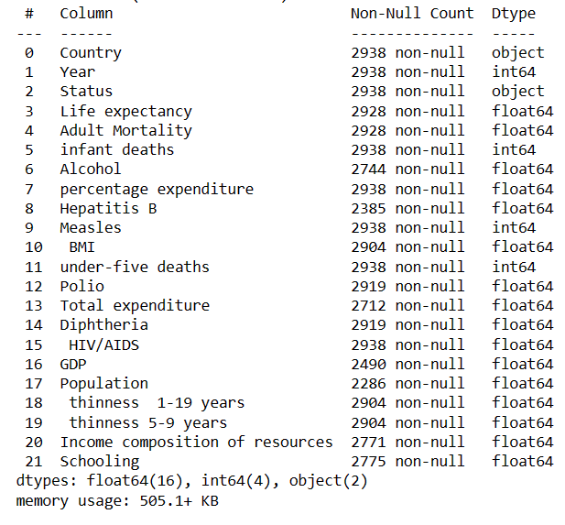
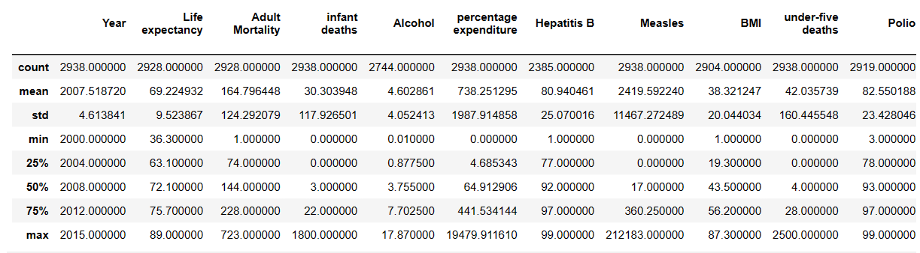
Statistical description

Slide 8
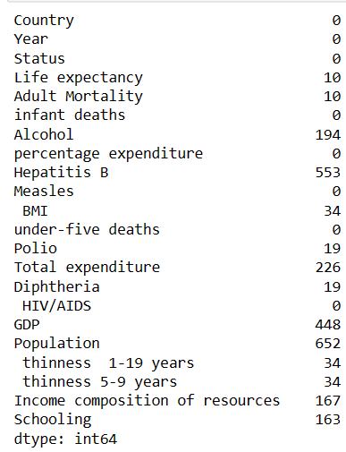
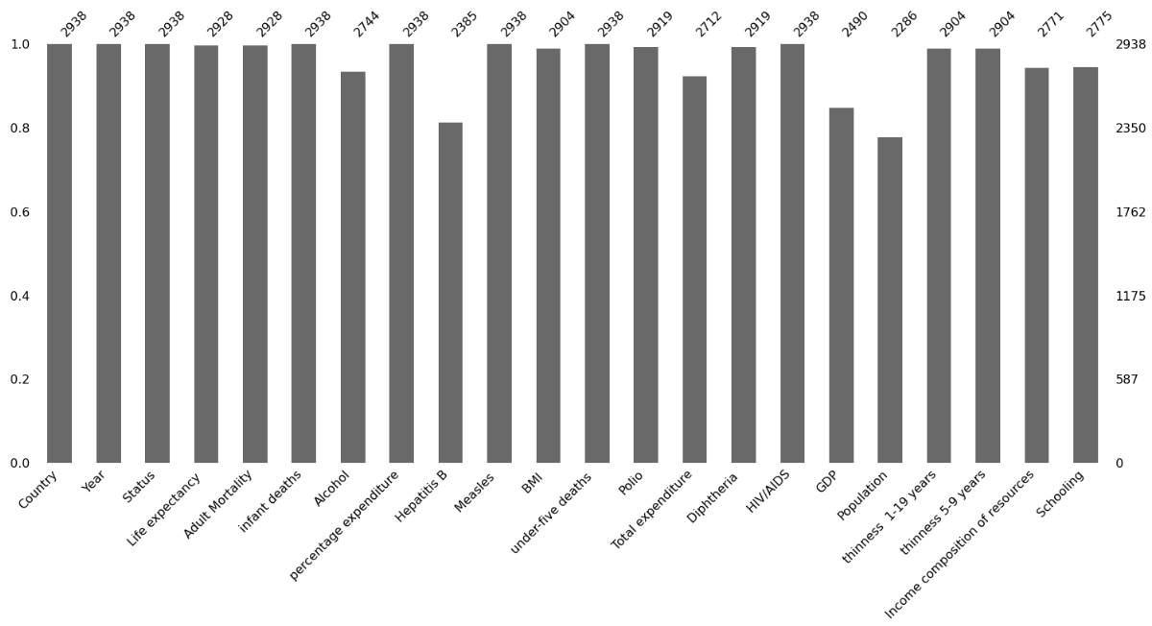
Data Cleaning
● we can see that many attributes have missing values, like Hepatitis B has 2385 values, whereas the expected number of values for every attribute is 2938. Now we have to find a way to fill in all these missing values as these may cause problems for our algorithm. We'll use the impute method of pd.DataFrame.fillna and impute the median values in all these missing fields.

Slide 9
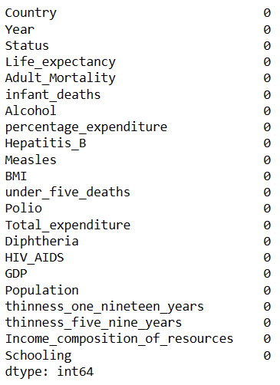
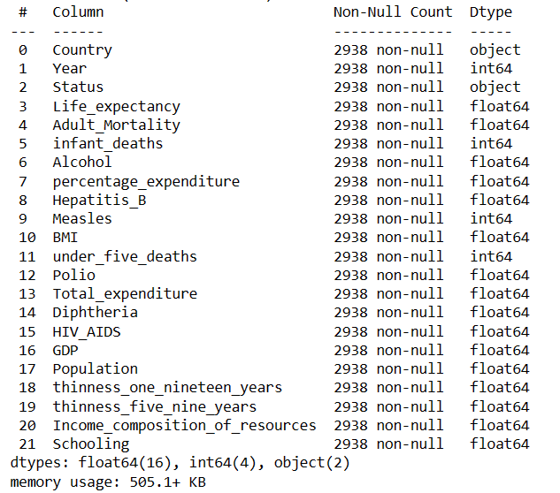
After Handling the Null Values
● Data cleaning and preprocessing is very essential to get an overall feel of the data. Preprocessing is important to feed the data further in the algorithms so that they can work effectively!

Slide 10
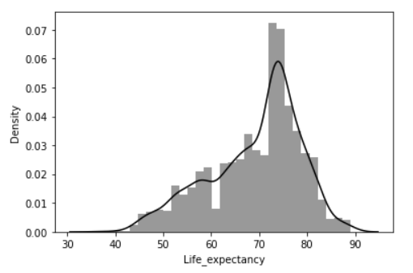
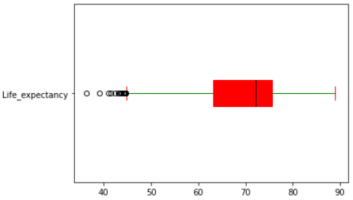
Target variable Visualisation
Life_expectancy

Slide 11
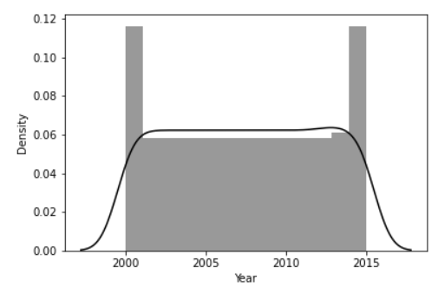
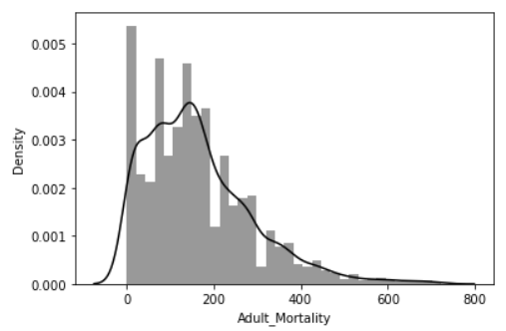
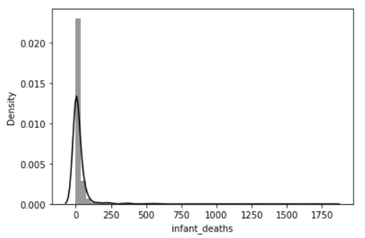
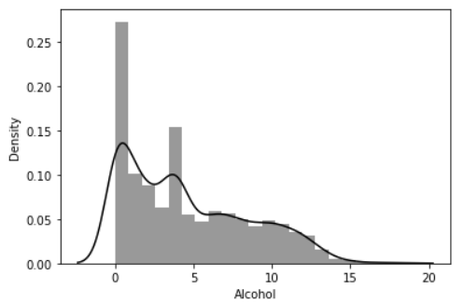
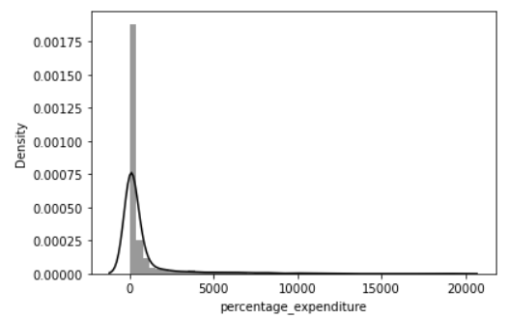
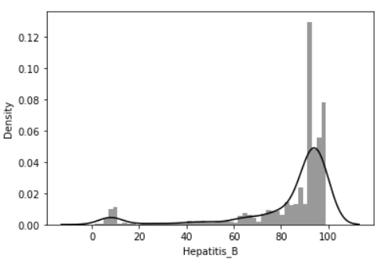
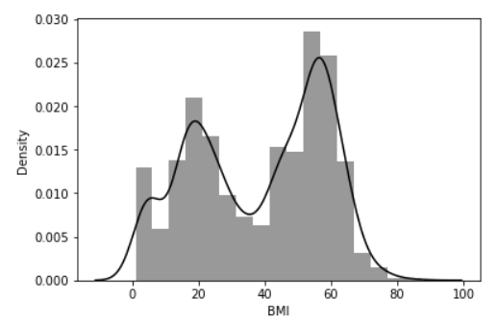
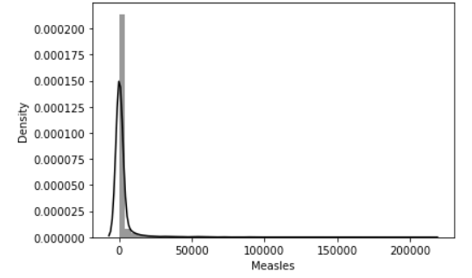
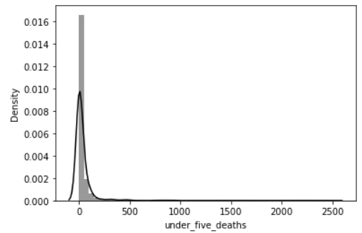
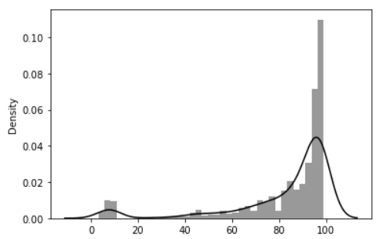
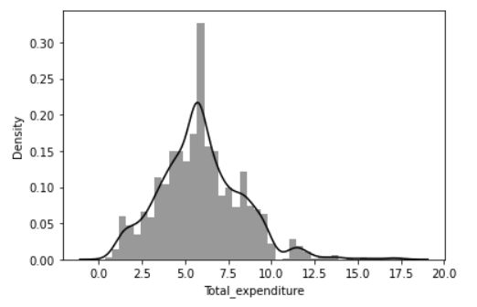
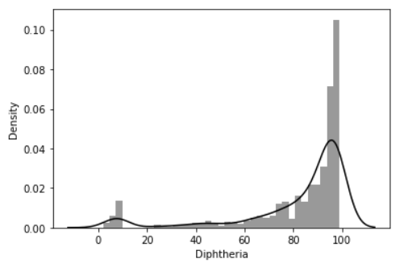
Visualizing data

Slide 12
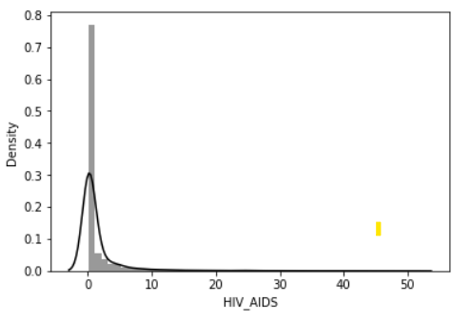
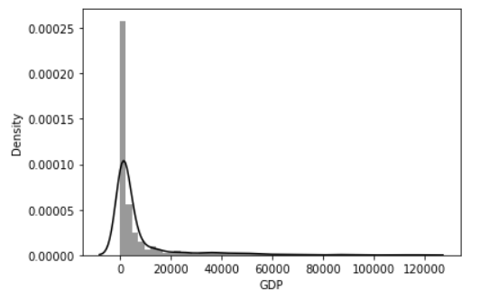
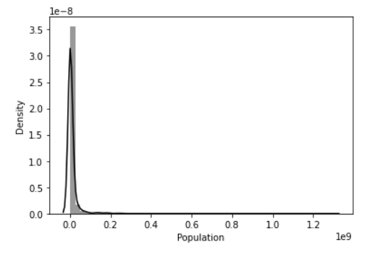
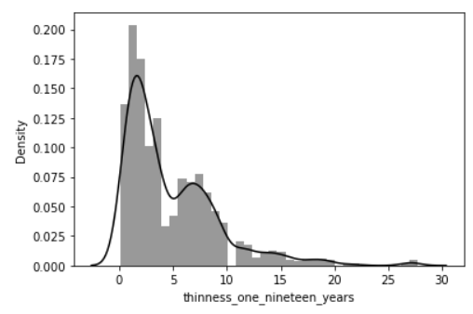
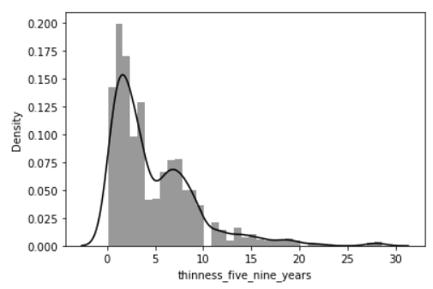
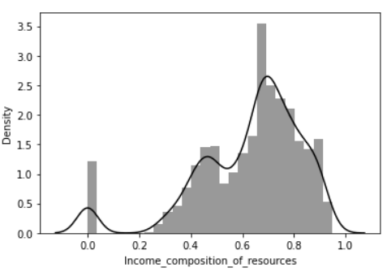
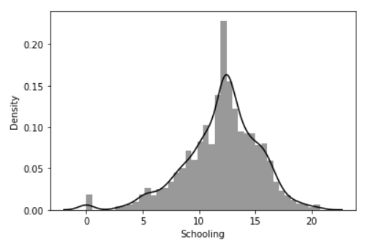
Visualizing data​

Slide 13
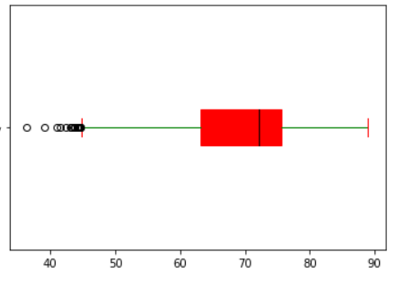
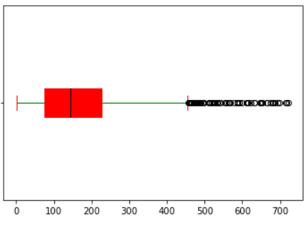
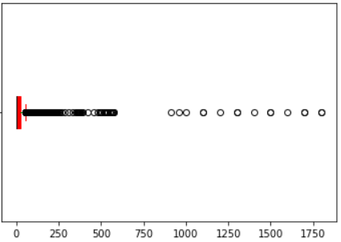
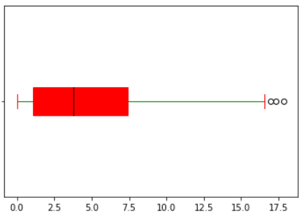

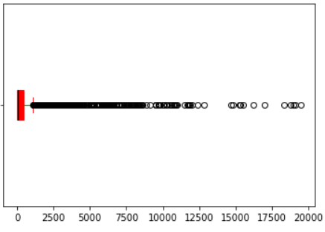
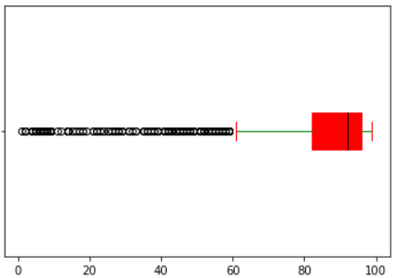
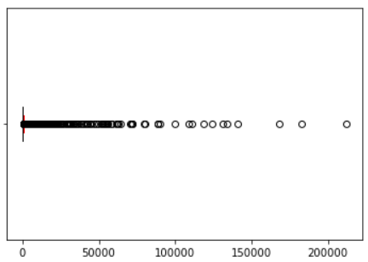
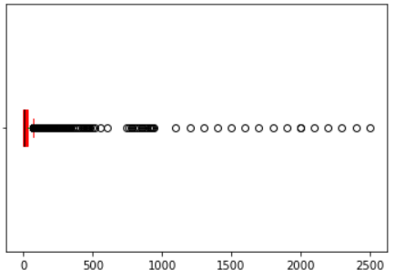
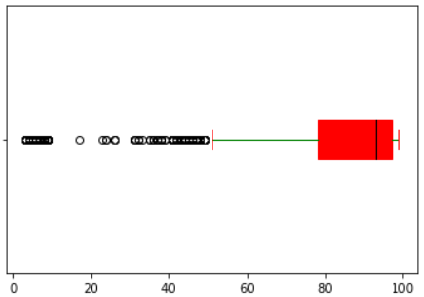

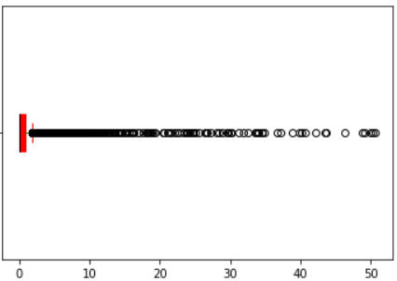
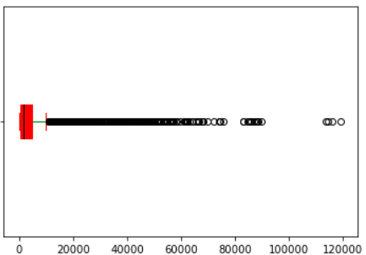
Outlier Detection

Slide 14
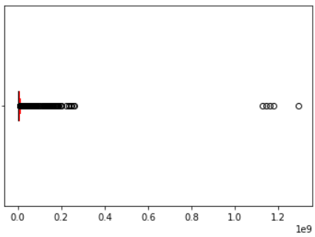
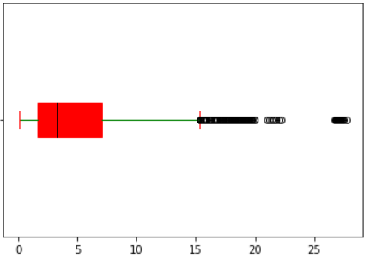
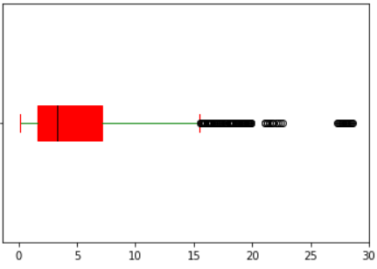
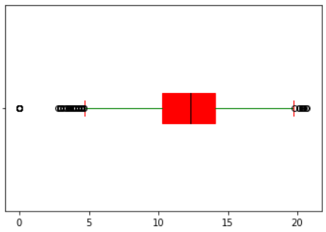

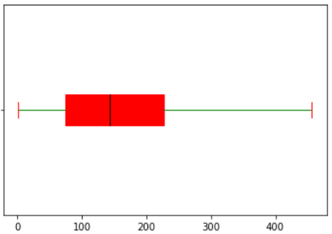
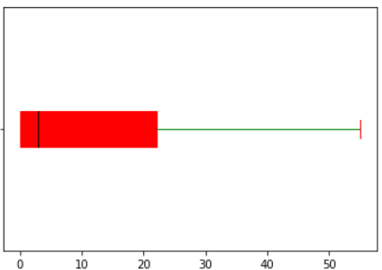
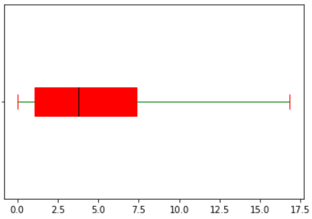
Outlier Caping
In this technique, the outlier is capped at a certain value. we have used IQR method to cap the outliers

Slide 15
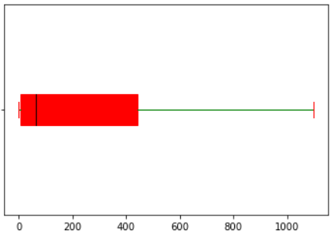
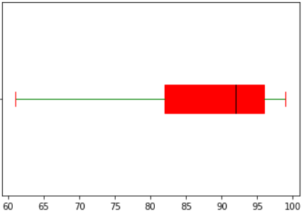


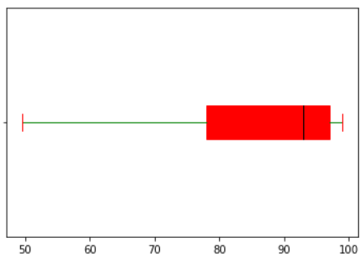
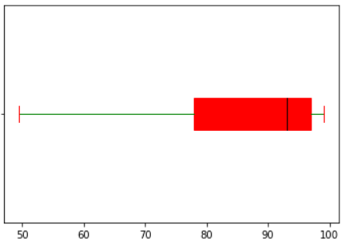

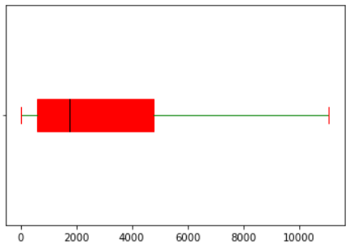




Outlier Caping​
​

Slide 16




Country
Top 10 Countries with Most Life_expectancy
Top 10 Countries with Least Life_expectancy
Status

Slide 17


Feature Selection: Feature Selection using Correlation Analysis & VIF

Slide 18

Handled Data
● After doing feature selection using correlation analysis, VIF(variance inflation factor) method we get a new updated dataset containing 11 columns and 2938 rows.

Slide 19

Model Creation
Building multiple models to find best accuracy
OLS Method

Slide 20

Model Creation

Slide 21


Models Comparision

Slide 22
Conclusion
We tried to build a prediction model for the Life Expectancy in which we need to predict the Best Accuracy score .
For that first we needed to understand the data
Then visualise it and handle the data appropriately
And do the Feature Selection Analysis
Finally build multiple model to evaluate and to find the best suited model to get good accuracy score and predict the target.
In that Random forest model showed the highest accuracy .so, we used it to predict the data.

Slide 23
Recommendation
1. The Developed countries should help developing countries in eradicating the diseases which are affecting the life of the people by providing vaccinations
2. The government should focus more on the schooling of the kids which will become face of the country in future and provide them with good food and educate them properly.
3. The governemnt of developing countries should launch various schemes to motivate people to send their kids to schools
4. Government should organize free healthcare camps to provide free vaccinations for the needy and poor people so that they dont have to spend their precious money and they also stay healthy to treat their families well.
5. The government should increase the subsidiy on liquor and increase healthcare and welfare camps to generate awareness among people, how band overdrinking is and how it affects your body.
6. WHO should with the help of developed nations should help the governemnt of developing countries in providing free food and education and organize healthcare camps

Slide 24

Thank you

